Slide 1
Introduction to Google Earth Engine in Javascript
A Hands-on Workshop to get started with GEE
Ujaval Gandhi
ujaval@spatialthoughts.com
Spatial Thoughts
This presentation → https://bit.ly/intro-to-gee-js

Slide 2
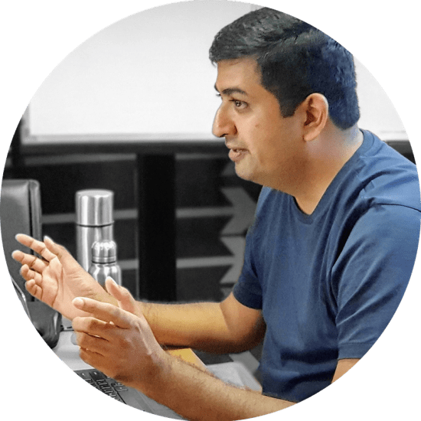
Introduction
Background in GIS and Remote Sensing
  Intern at Indian Institute of Remote Sensing (IIRS), Dehradun, India
  MS in Geospatial Information Engineering from University of Wisconsin - Madison, USA
15 years of professional experience
  One of the early employees at Google Inc.
    Moved to India in 2006 and established the maps team
    Led the GIS and Aerial Imagery team in India from 2007-2019
  Developed expertise in Google Earth Engine and trained 1000+ scientists and researchers across India
  Left Google in March 2020.
Presently
  Focused full-time on teaching and building content at Spatial Thoughts
  Active Earth Engine developer and trainer
  Co-author of the open-access book Earth Engine Fundamentals and Applications (eefabook.org)
Ujaval Gandhi

Slide 3
TAs
Emil Cherrington
Samapriya Roy
Ziu Lin

Slide 4

What is Google Earth Engine?
Google's cloud platform for easy petabyte-scale analysis
Data
An exhaustive catalog of remote sensing datasets, including multispectral, radar, aerial, climate, land cover, and vector.
Computation
Colocated data storage + computation
API
Simple, yet powerful JavaScript and Python API
Browser-based IDE
No software to download or keep up to date. All you need is a modest internet connection.

Slide 5
What can you do in Earth Engine?
Image Processing (Map Algebra, Kernels and Convolutions, Spectral Unmixing, Pan-sharpening, Gap Filling, Data Fusion)
Vector Processing (Zonal Statistics, Spatial Joins, Spatial Query etc.)
Terrain Processing (Slope, Aspect, Hillsahde, Hill Shadow Analysis)
Time Series Analysis (Extract Time-Series, Trend Analysis, Time-Series Smoothing, Temporal Segmentation etc.)
Object-based Image Analysis (GLCM, Texture, Hotspots etc.)
Change Detection (Spectral Distance, Change Classification, Class Transitions)
Machine Learning (Supervised and Unsupervised Classification, Linear Regression, Principal Components Analysis etc.)
Deep Learning (DNN, Object Detection etc. via Tensorflow)

Slide 6
What you CANNOT do in Earth Engine?
Create Cartographic Outputs
3D visualization and analysis
Run Hydrological models (i.e. Rainfall-runoff modeling) and analysis (i.e. watershed delineation, fill depression etc.)
Photogrammetry (i.e. Orthorectification, Point-Clouds etc.)
LIDAR processing
SAR Interferometry

Slide 7
Workshop Overview
Part 1 (3 Hours)
Data Discovery, Processing and Export
Part 2 (2 Hours)
Computation in Earth Engine
Javascript Basics
ImageCollections
Filters
Creating Composites
FeatureCollections
Export
Map/Reduce Programming Concepts
Calculating Indices
Computation on ImageCollections
Time-series Charts

Slide 8
Workshop Structure
We will have 10-15 minutes of explanation of a concept, followed by a 5-minute exercise
  All participants are expected to complete the exercises during the class.
You can ask questions at any point during the session.
We will have lunch break from 12:30pm-1:30pm

Slide 9
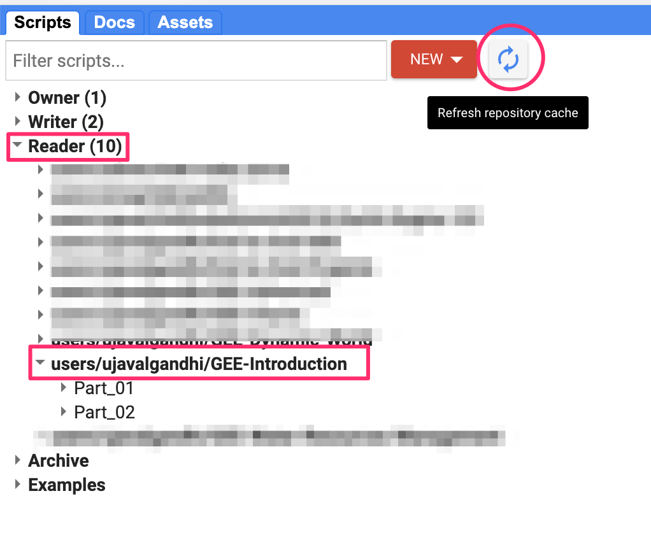
Get the Workshop Materials
This presentation → https://bit.ly/intro-to-gee-js
You will need a Google Earth Engine account for this workshop. Sign-up if you do not have one.
Get the workshop repository → Click this link to open Google Earth Engine code editor and add the repository to your account.
If successful, you will have a new repository named users/ujavalgandhi/GEE-Introduction in the Scripts tab in the Reader section.
If you do not see the repository in the Reader section, click Refresh repository cache button in your Scripts tab.

Slide 10
Let’s get coding

Slide 11
What is your favorite programming language?

Slide 12
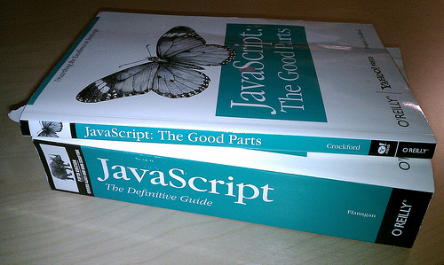
Image Source: Reddit

Slide 13
Javascript vs. Python
You are learning the Earth Engine API
The API is exactly the same regardless of the language you choose
  With a few small caveats
Javascript API is the most mature and easiest to get started.
  No installation required
  No need to worry about authentication
  Very easy to share scripts, ask for help
  Building and deploying apps is very easy
Python API is much more powerful
  Integrate with other data science libraries for data processing and plotting
  Automate launching and managing Exports
We will focus on Javascript for this workshop.
  You can automatically convert any Javascript code to Python [tutorial]

Slide 14
Part 1:
Data Discovery, Processing and Export

Slide 15
Quiz 1
This presentation → https://bit.ly/intro-to-gee-js

Slide 16
Part 2:
Computation in Earth Engine

Slide 17
Spectral Indices and Band Ratios
Notes:
https://medium.com/regen-network/remote-sensing-indices-389153e3d947

Slide 18
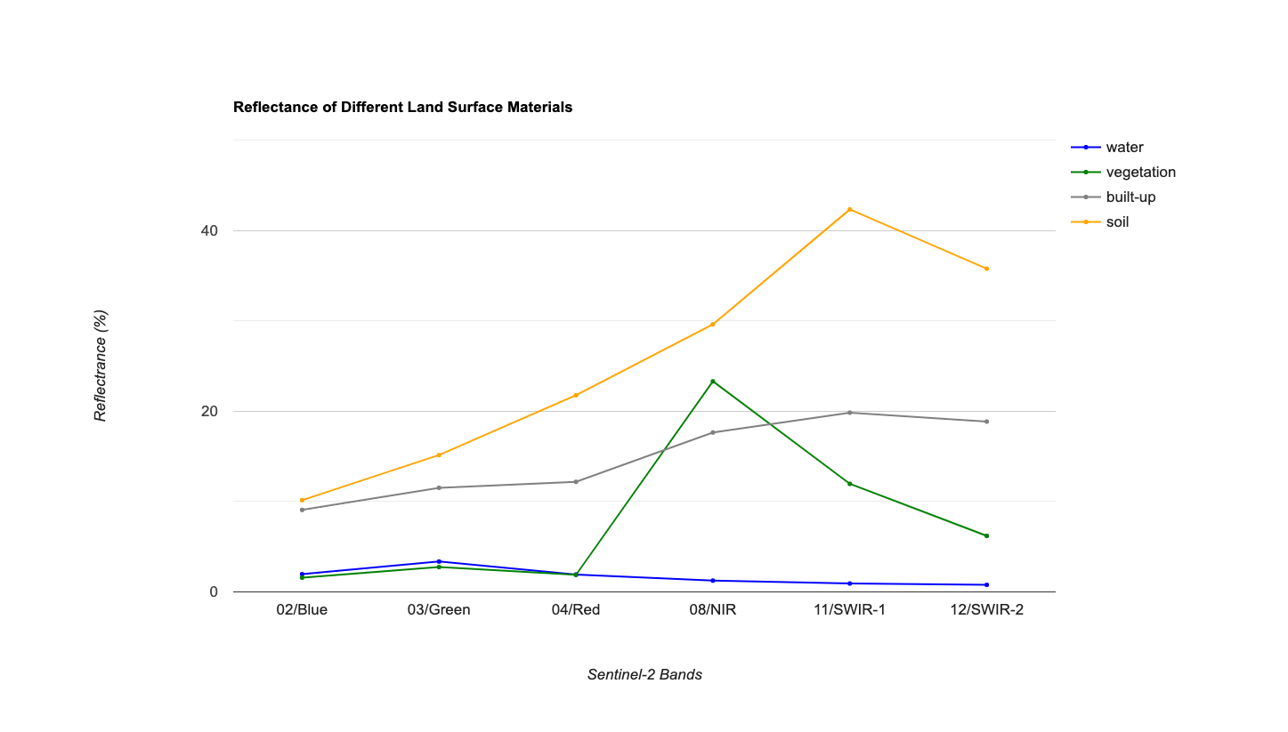

Slide 19
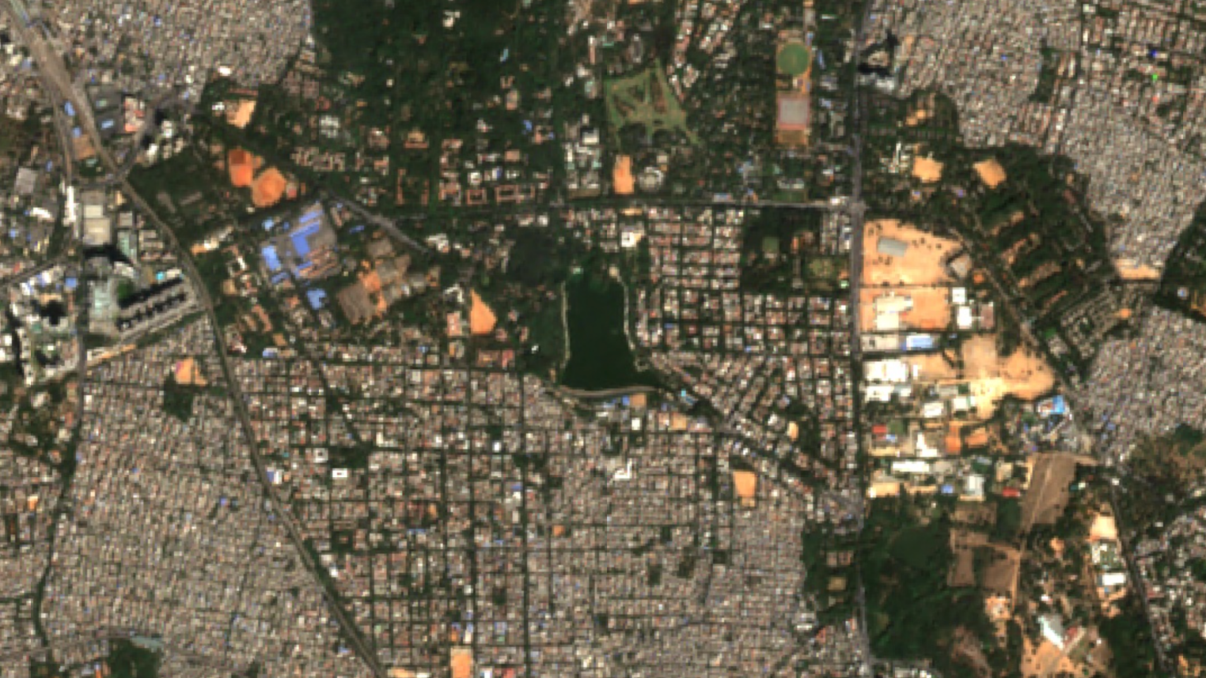
Sentinel-2 SR Image

Slide 20
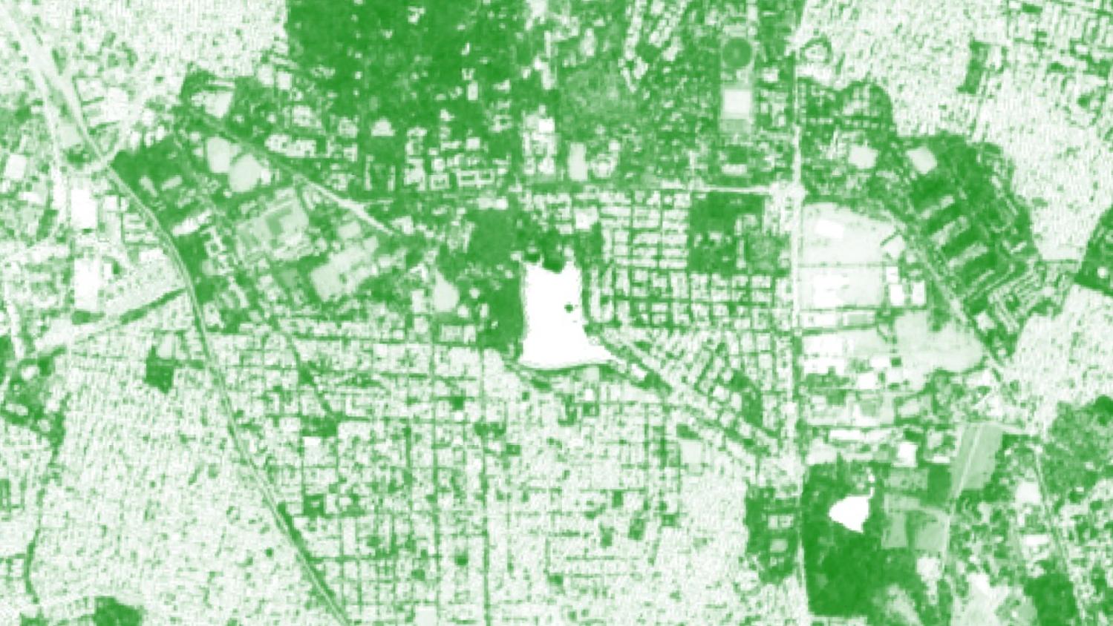
Normalized Difference Vegetation Index (NDVI)
(NIR - Red) / (NIR + Red)

Slide 21
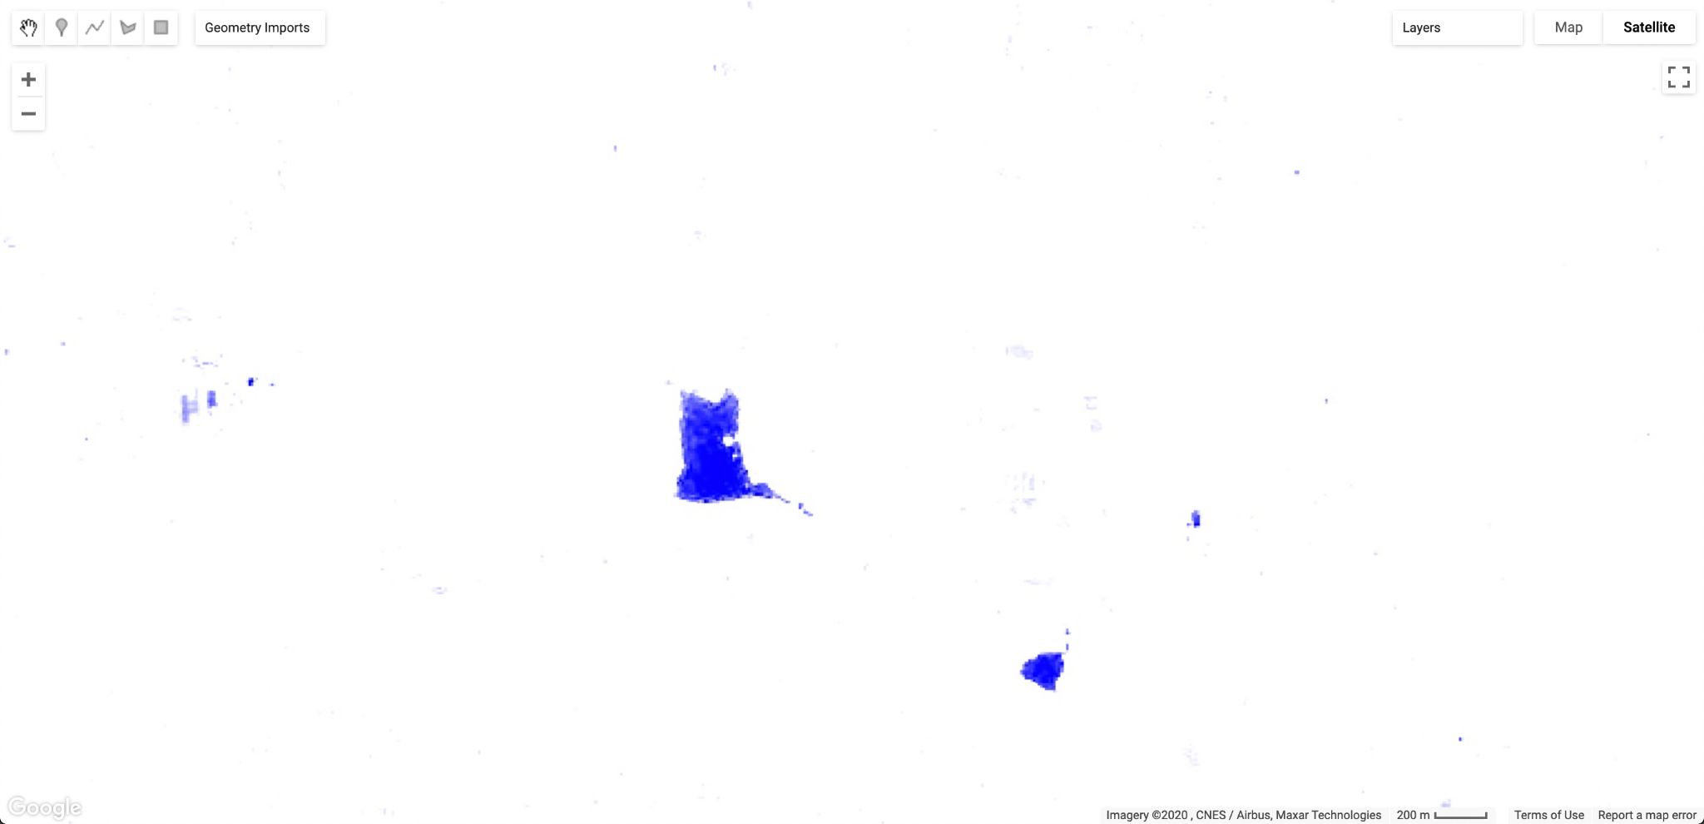
Normalized Difference Water Index (NDWI)
(Green - NIR) / (Green + NIR)

Slide 22
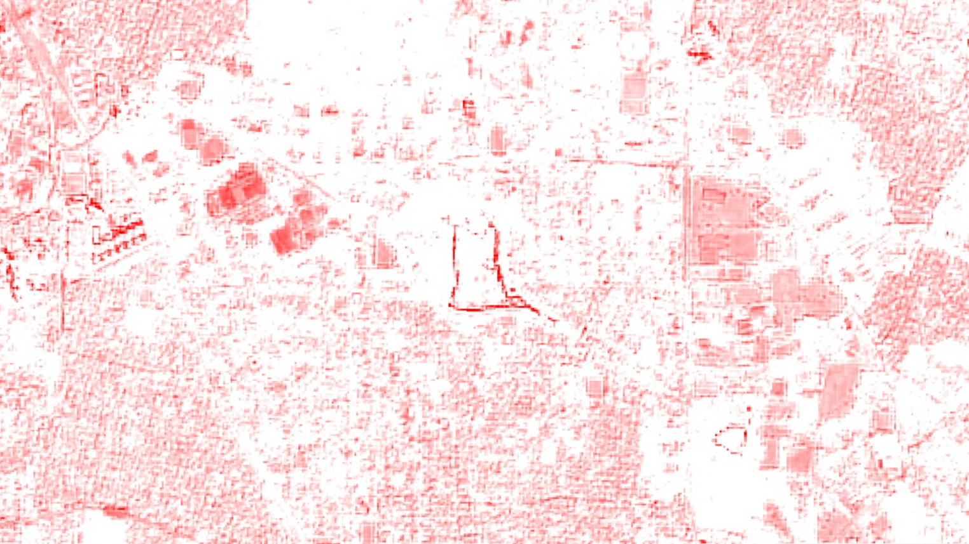
Normalized Difference Built-Up Index (NDBI)
(SWIR-1 - NIR) / (SWIR-1 + NIR)

Slide 23
Map/Reduce Programming Concepts

Slide 24


Requests
Results
Geospatial
Datasets
add
mosaic
distance
filter
Algorithmic
Primitives
join
focal_min
convolve
reduce
Storage and Compute

Slide 25
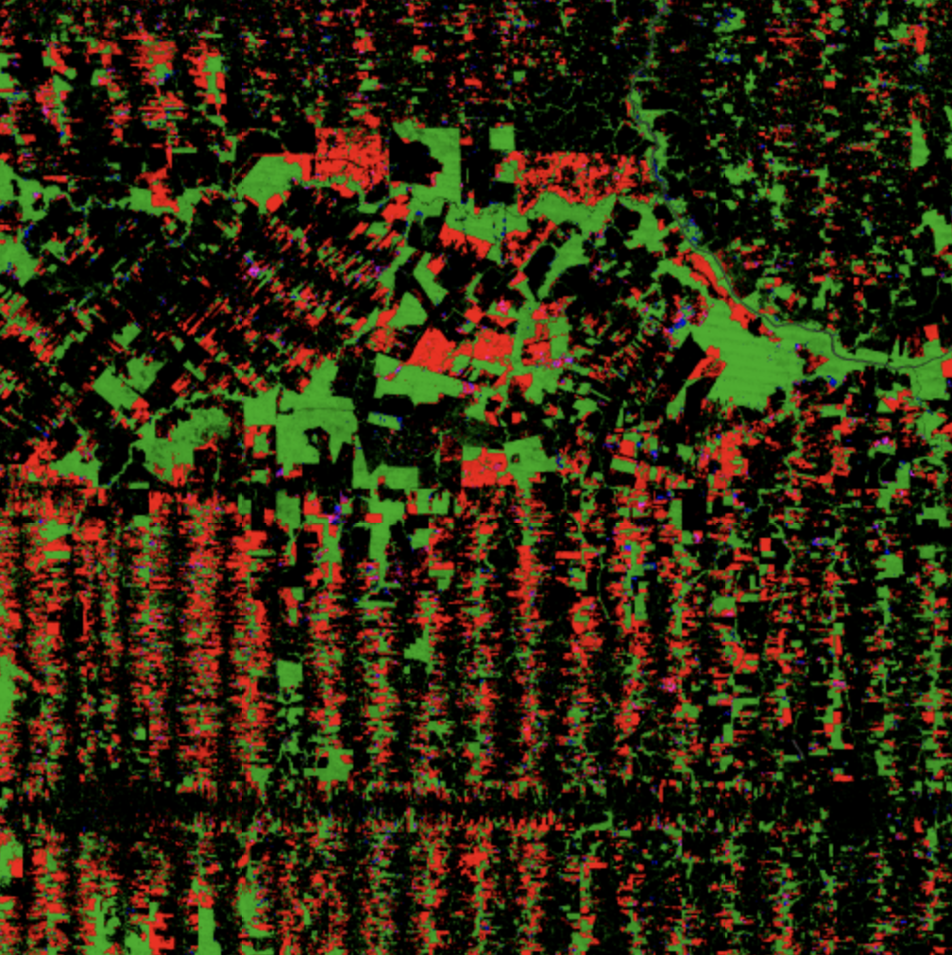

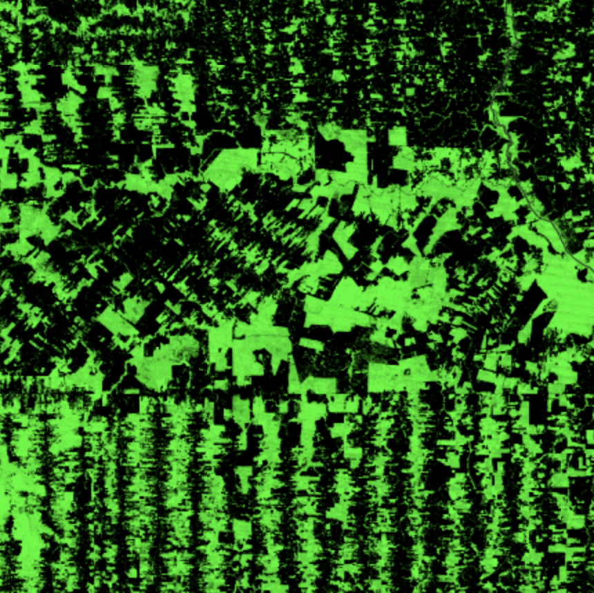
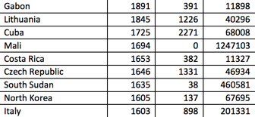
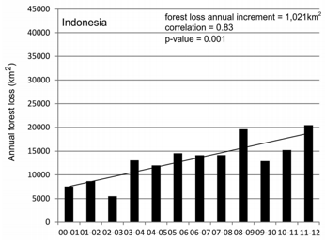
filter()
map()
reduce()

Slide 26
How to write parallel computing code?
Filter your collection to get a collection with desired data
Write a function to process a single image or feature
map() that function on your filtered collection
reduce() the resulting collection

Slide 27
map()
map() works on following Earth Engine objects
  List
  Dictionary
  ImageCollection
  FeatureCollection
You can run a map operation by calling the map() function

Slide 28
reduce()
Earth Engine provides built-in reducers ( ee.Reducer… )
Reducers work on following Earth Engine objects
  List
  Image
  ImageCollection
  FeatureCollection
You run a reducer by calling the reduce() function

Slide 29
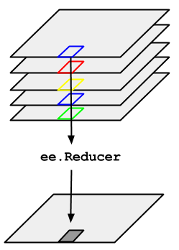
Reducing Image Collection
Creates an Image
Reducer is applied per pixel across images
Example
  Creating composites
Images in the Collection

Slide 30

Reducing Image Region
Creates a number of a dictionary
Reducer is applied on all pixels of each band
Example
  Calculating area
  Calculating average NDVI in a farm

Slide 31
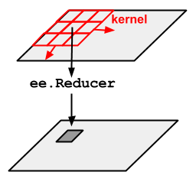
Other types of reducers
Convolutions (reduceNeighborhood)
Zonal Statistics (reduceRegions)
Statistics on Attribute Tables (reduceColumn)
Raster to Vector conversion (reduceToVectors)
Vector to Raster conversion (reduceToImage)
Linear Regression (linearFit, linearRegression)

Slide 32
Tips for programming
If/else conditions
  filter / map / merge / reduce
  See example
Learn more about Reducers
  https://courses.spatialthoughts.com/gee-advanced.html#reducers

Slide 33
Quiz 2

Slide 34
Feedback
Please fill this 2-minute anonymous feedback survey,

Slide 35
Resources
Earth Engine User Guide
Awesome GEE Community Catalog
Earth Engine Fundamentals and Applications (EEFA)
  Open access book [PDF] [Text] [Videos]
  50 Chapters, 100+ authors
  Covering both GEE concepts and domain-specific applications
Spatial Thoughts OpenCourseWare
  End-to-End Google Earth Engine
  Google Earth Engine for Water Resources Management
  Creating Publication Quality Charts with GEE
  Earth Engine Advanced Concepts

Slide 36
Notes
S2 BRDF correction [paper] [code]
S2 Phenology Parameters [github]

